Slide 1


API Blueprint with Apiary.o
RESTful API Documentation

Slide 2
RESTful Web-service
Machine-to-Machine Communication (Server/Client)
Stateless access to (dynamic) ressources
Uses standard HTTP-methods
One uniform interface for all Clients
Supports all internet media types (but JSON is used most)

Slide 3
API Blueprint
Documentation of RESTful API
Open-Source

Slide 4
API Blueprint – Markdown Language
Easy to learn
Commonly used on GitHub, StackOverflow, etc.
Can be converted to HTML

Slide 5
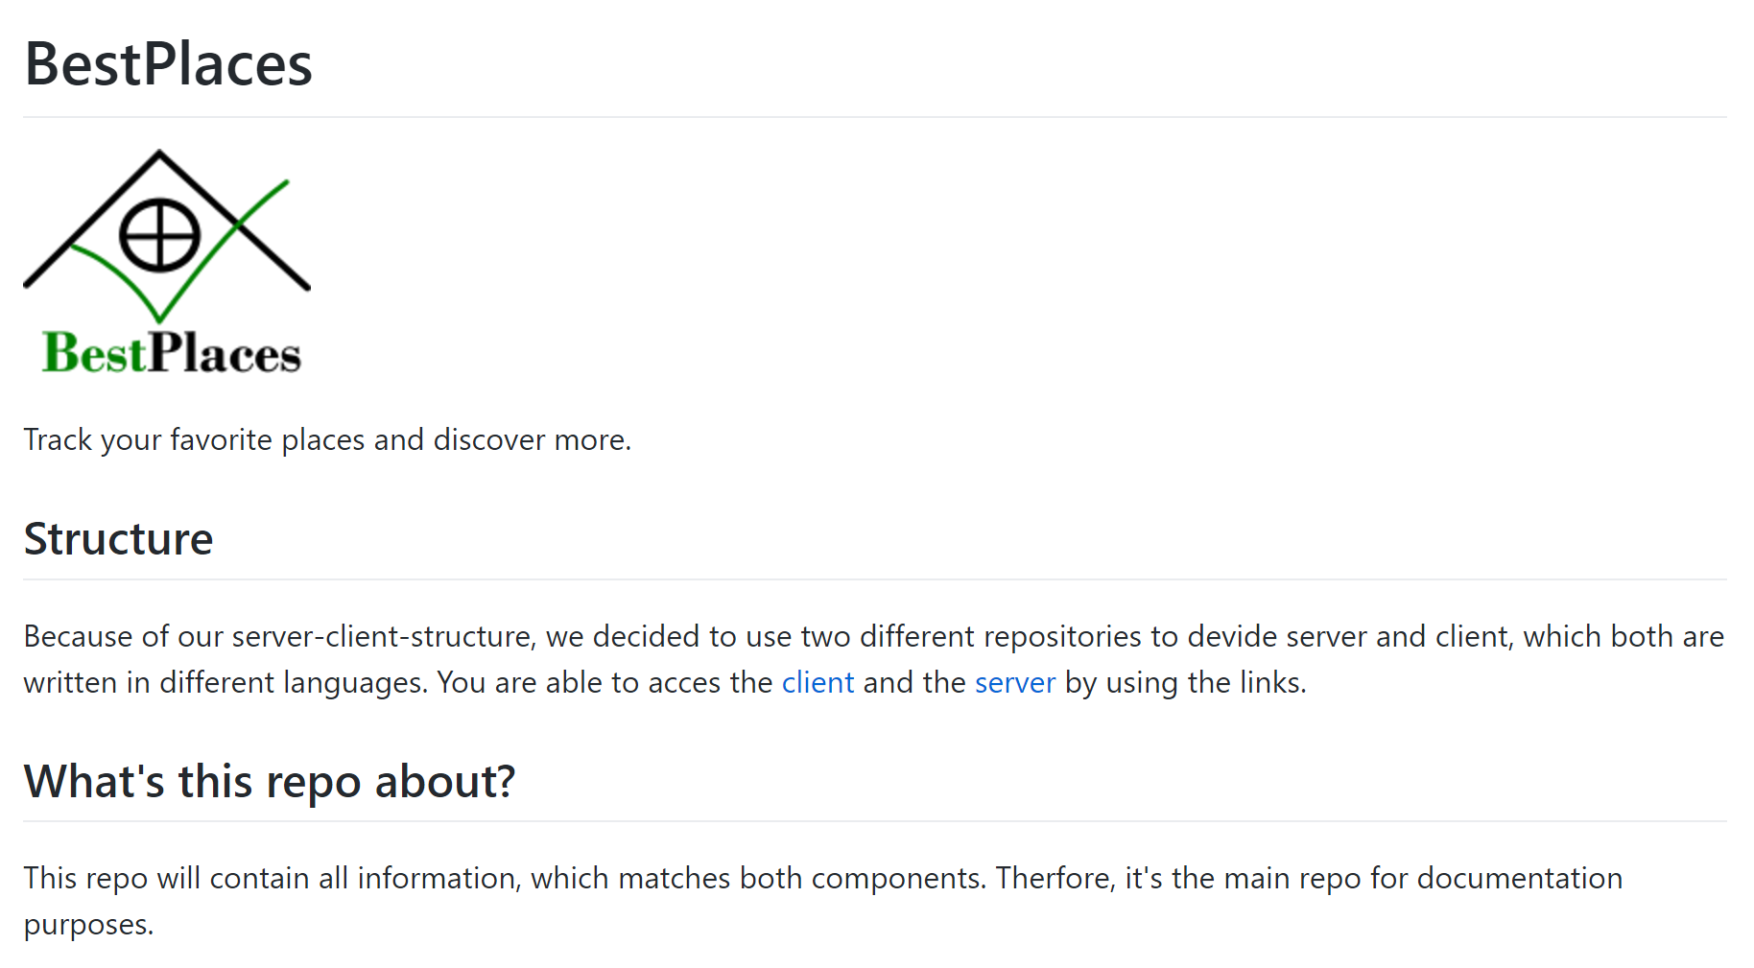
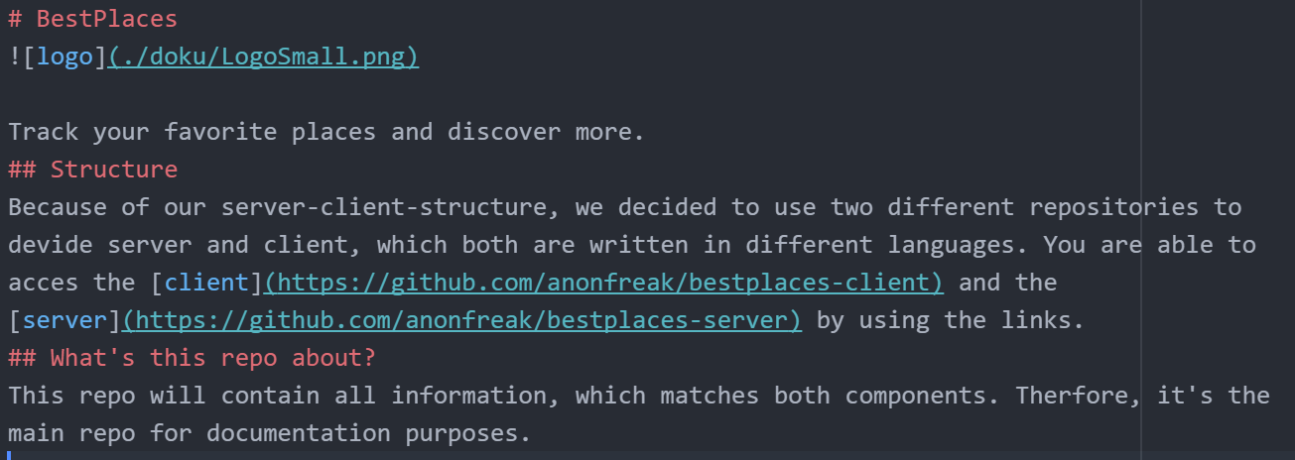
API Blueprint – Markdown Language
Plain Markdown
Markdown Compiled

Slide 6
API Blueprint - Features

Slide 7
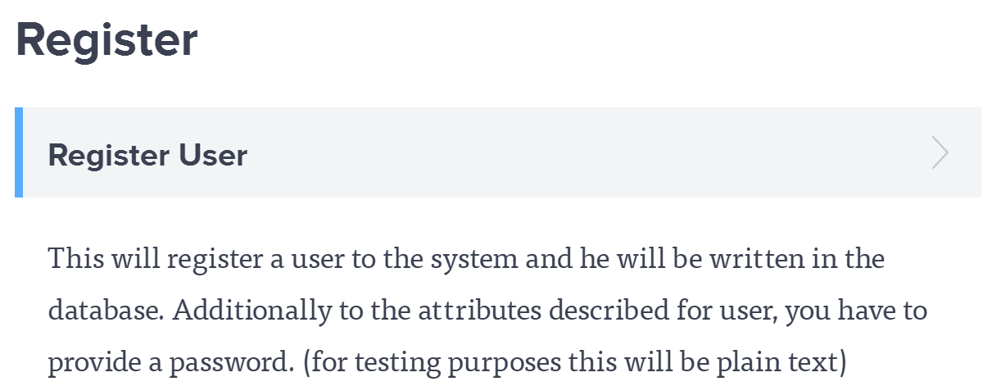
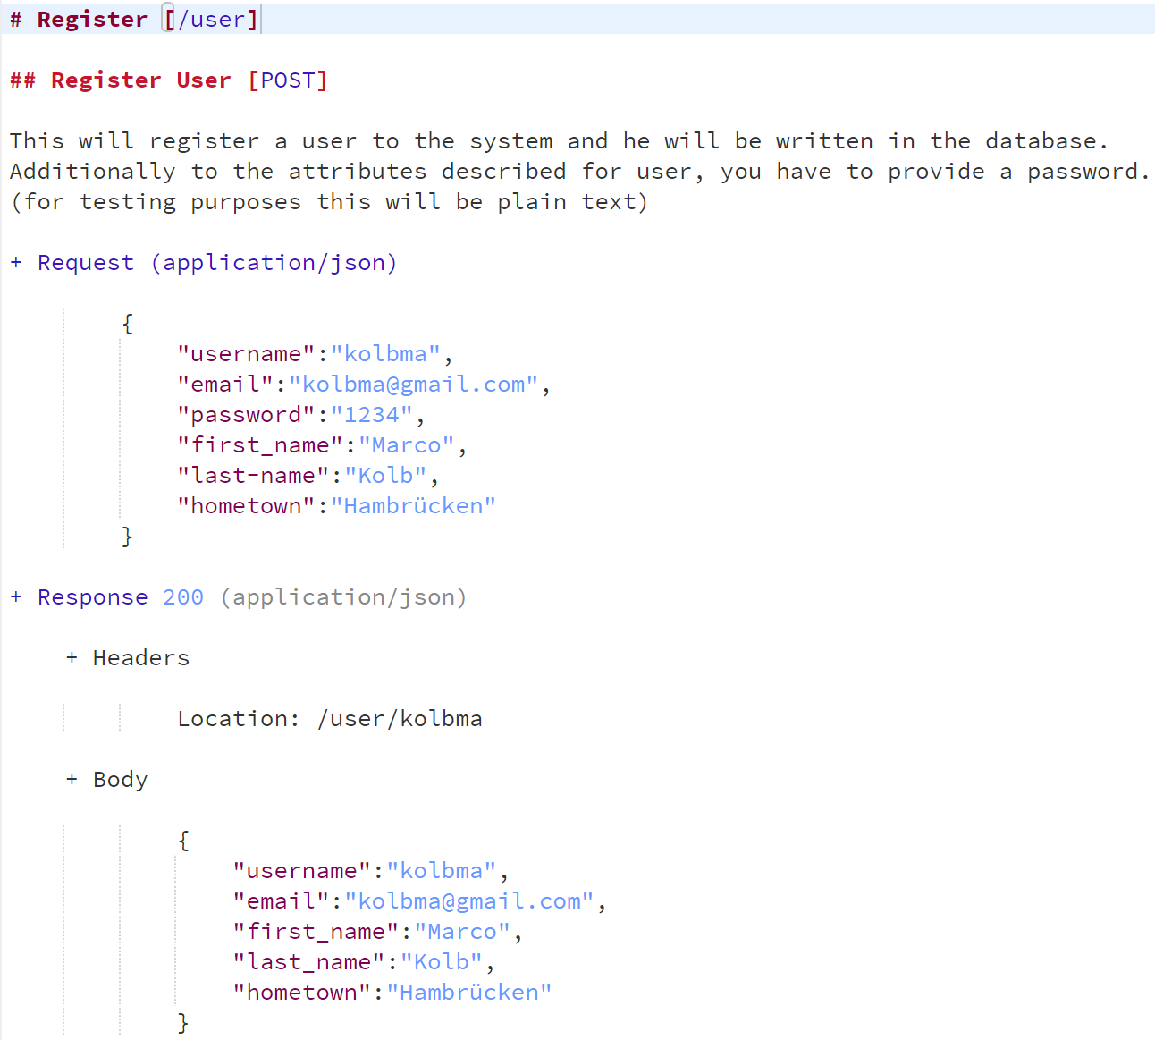
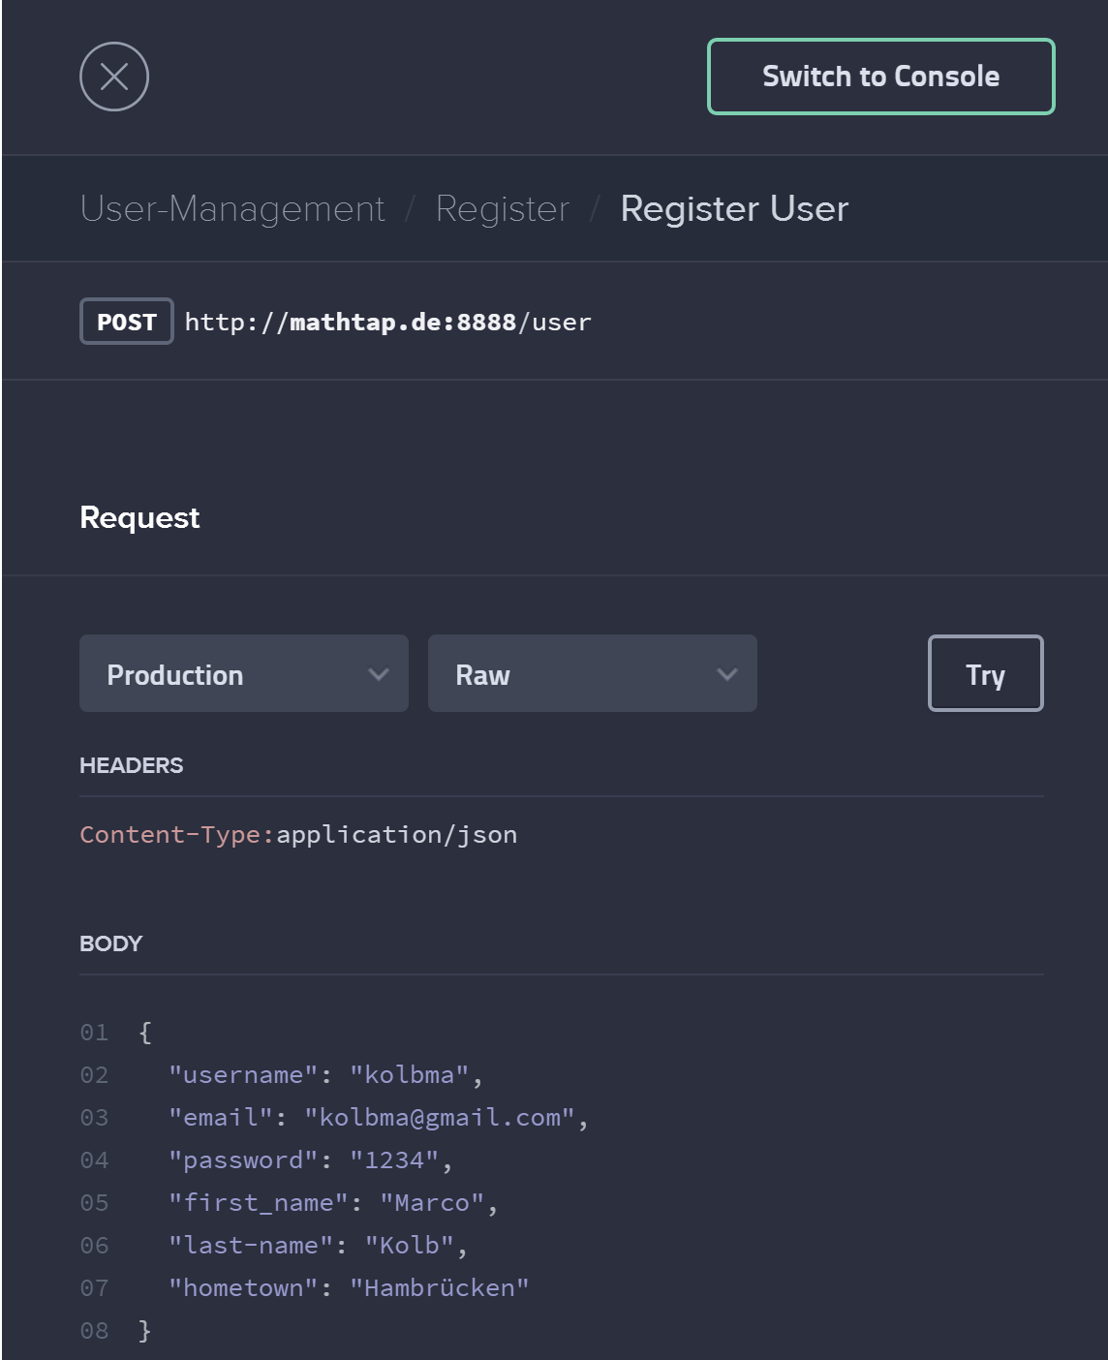
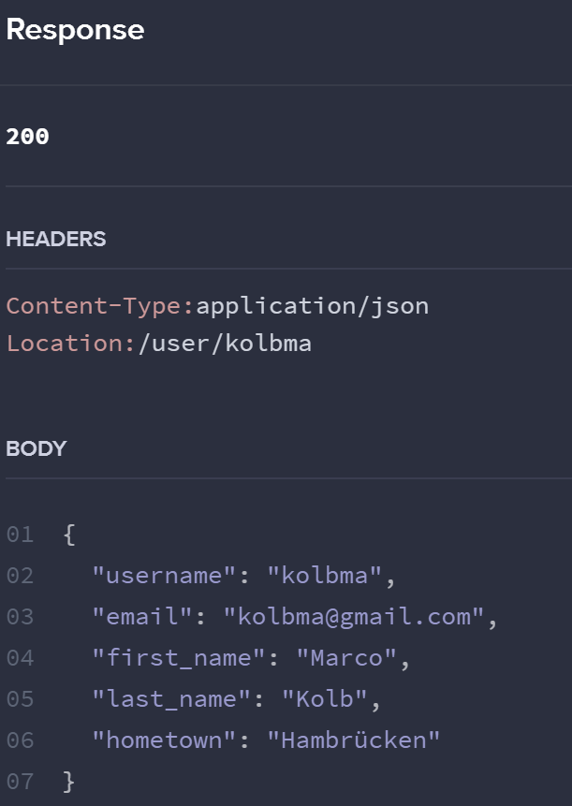

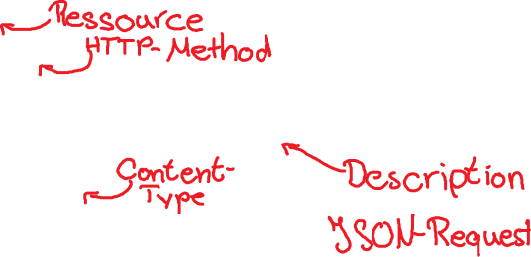

Slide 8
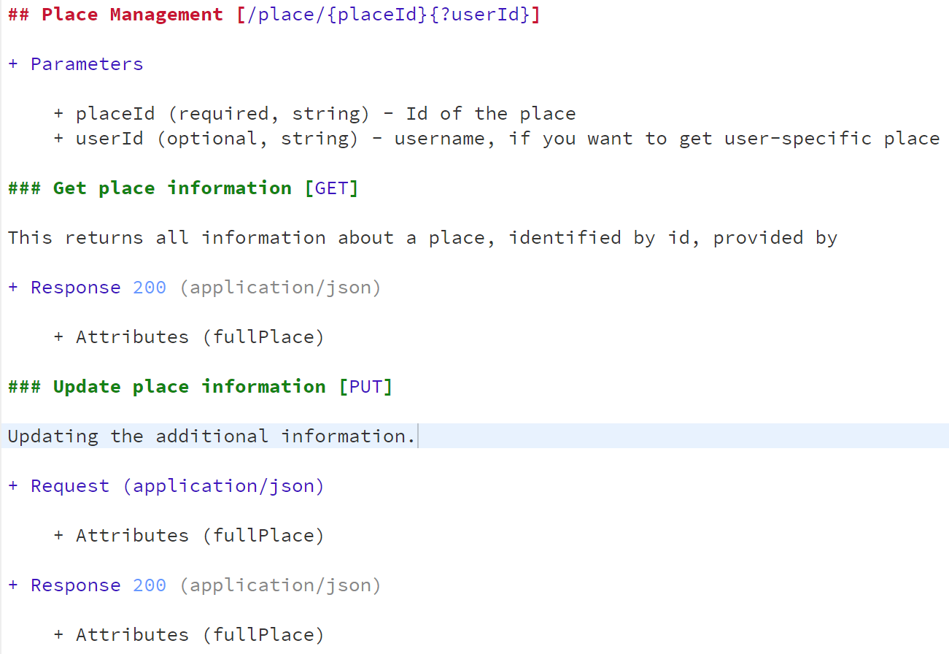
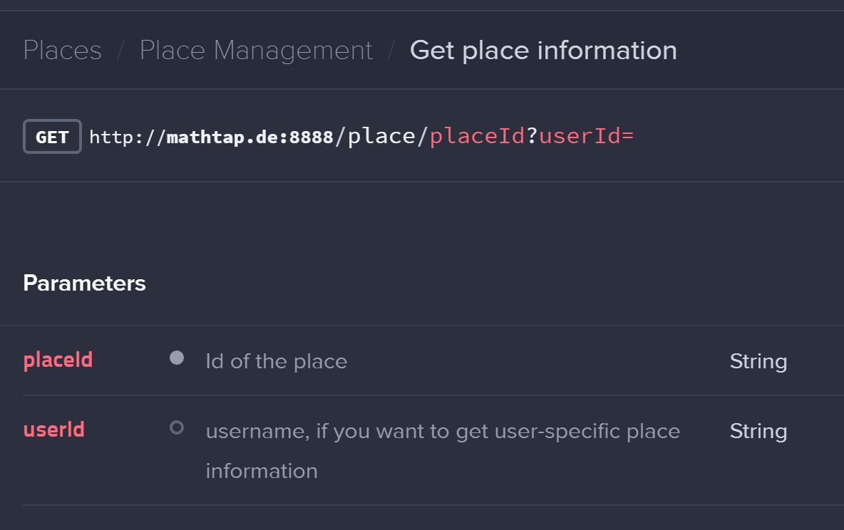



Slide 9
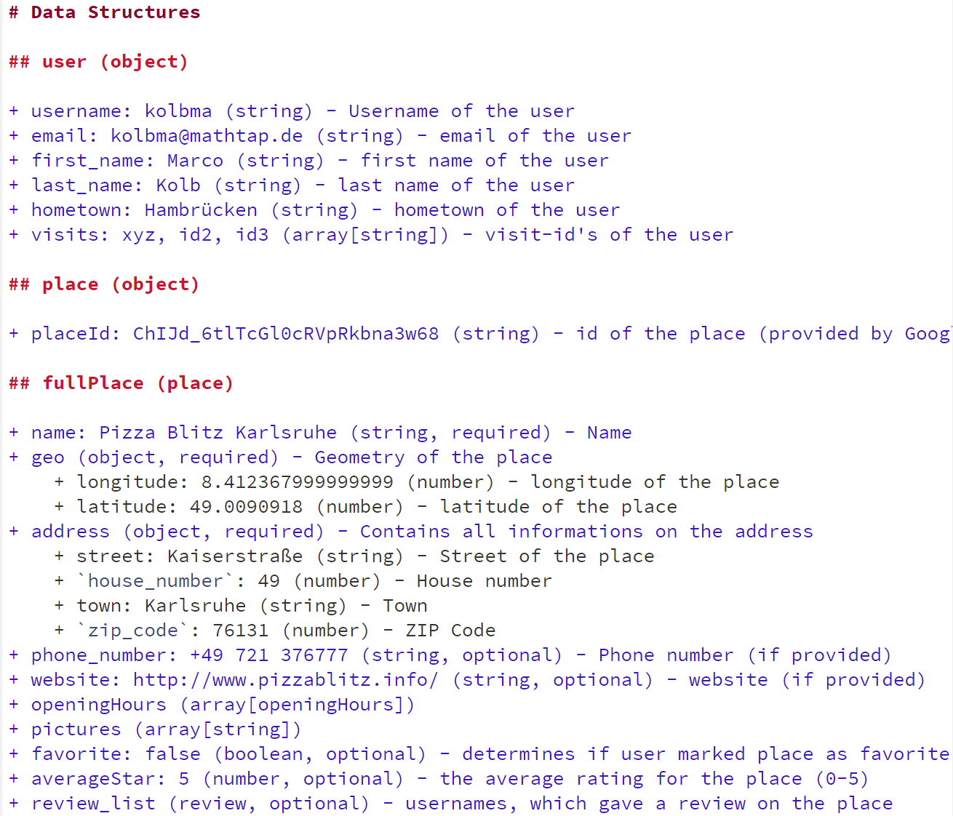
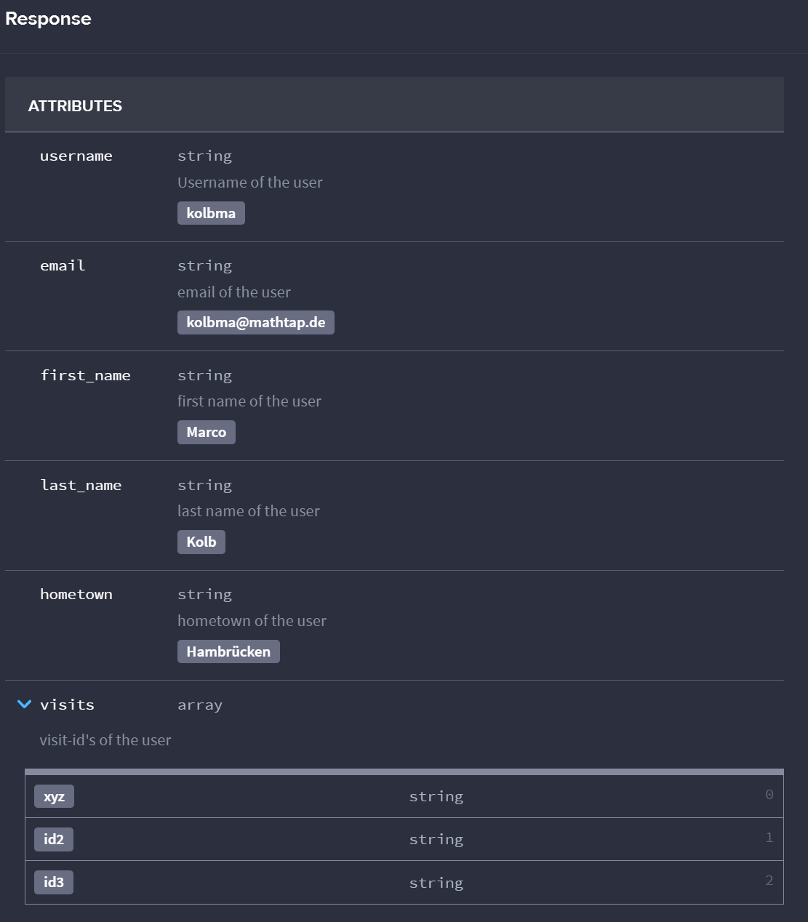




Slide 10
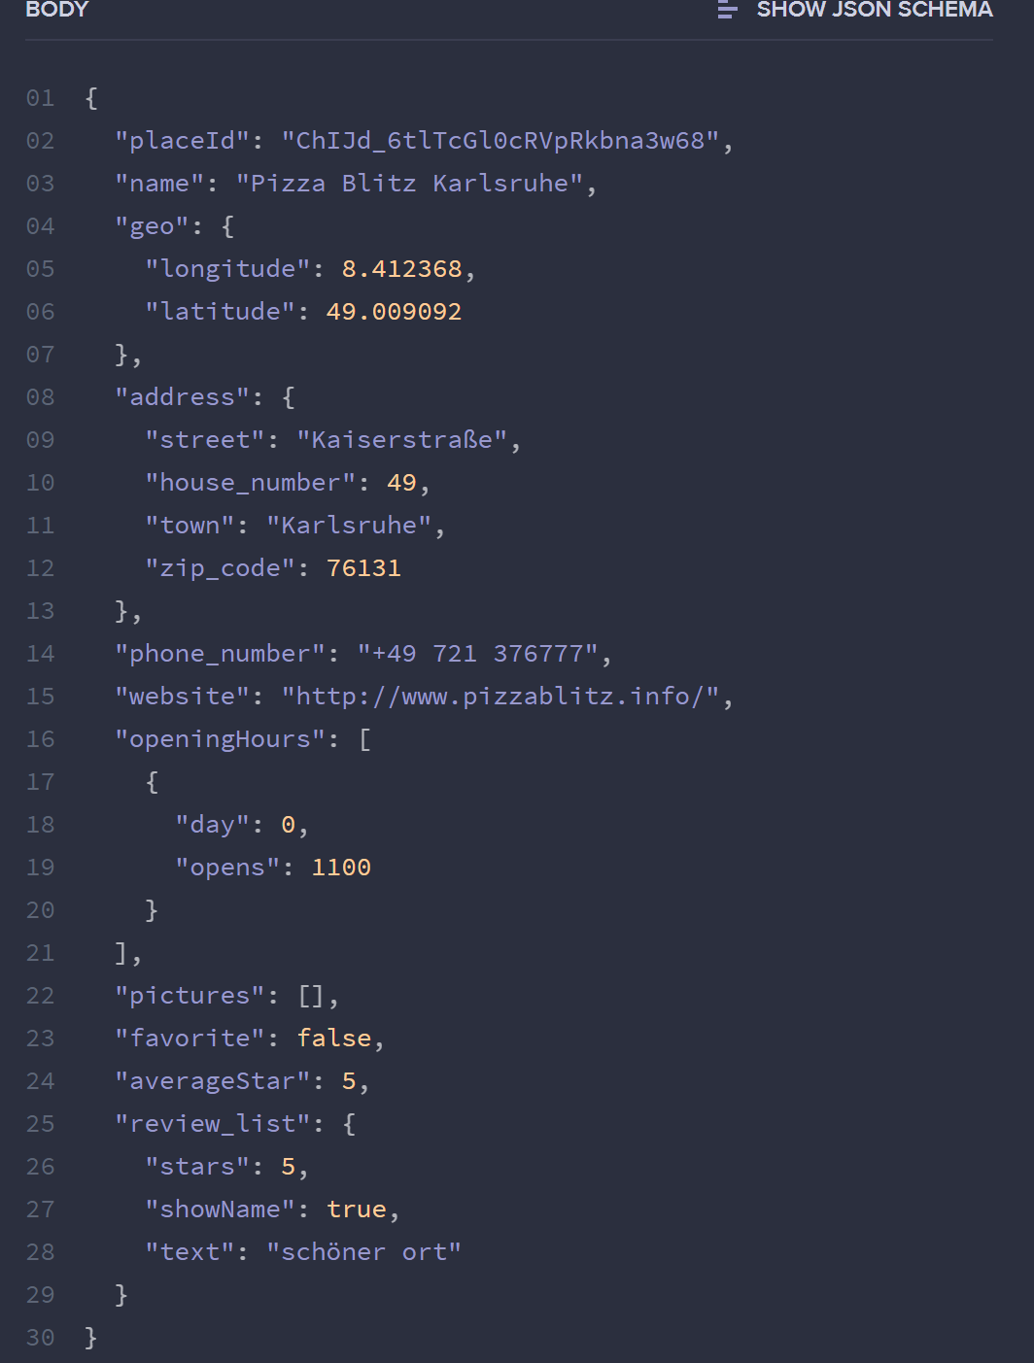

Slide 11
API Blueprint - Benefits
Design-First Philosophy
API worked out and defined before development (=> no changes during development)
Backend and Frontend-Developers know how to implement and work with the API
Nice-looking Documentation with examples built-in

Slide 12
Cloud-Service for API Blueprint
Live-Preview
Console
Mocking-Server as Proxy for real API (=> mocks data only if real Interface isn‘t implemented yet)
Team collaboration
Automated testing with Dredd

Slide 13
Exercise
Create an API-Documentation on Apiary.io for a lottery company. This includes the following features:
Hand over the winning numbers (6 numbers + 1 „Superzahl“)
Request the winning numbers of a specific date
Request the recent winning numbers
https://github.com/anonfreak/bestplaces-server/blob/master/apiary.apib
https://jsapi.apiary.io/previews/bestplaces/reference
Work with objects and provide sample data for everything!

Slide 14
Reference
http://apiary.io/
https://github.com/apiaryio/mson
https://apiblueprint.org/documentation/

